Slide 1


Slide 2
About today…
Iterating over Arrays
Multidimensional Arrays
Array destructuring

Slide 3
Iterating Over Arrays
Fruits Array
["apricot", "apple", "blueberry", "cherry", "date", "fig"]
Fruits Array
Using for loop
for (let i = 0; i < fruits.length; i++) {
console.log(fruits[i]);
}
Using for...of loop
for (let fruit of fruits) {
console.log(fruit);
}
Using forEach() method
fruits.forEach(fruit => console.log(fruit));

Slide 4
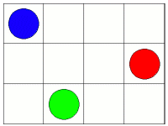


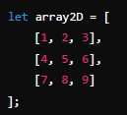

Multi-dimensional Arrays
let matrix = [
[1, 2, 3],
[4, 5, 6],
[7, 8, 9]
Arrays that contain other arrays
]
Defining empty
Updating value
Defining with data
Viewing value

Slide 5


Array Destructuring
Fruits Array
["apricot", "apple", "blueberry", "cherry", "date", "fig"]
Extracting values from arrays into distinct variables

Slide 6


Slide 7

Why iterating over arrays is required?
What is the structure of multi-dimensional arrays?
How array destructuring is helpful?

Slide 8

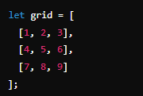
Task 1
Print the list of books array
Task 2
Task 3
Perform array destructuring
Swap the values of two variables using destructuring
Print the element in the first row and second column
Change the element in the third row and first column to 10
Add a new row [10, 11, 12] to the last of grid

